Slide 1
Dashboards using streamlit
CSC221(Advanced Python)

Slide 2
Content
Creating an app , adding text to application using streamlit
Creating an app and adding a STATIC Dashboard using streamlit
Creating an app and adding filters that allow manipulating a Dashboard using streamlit
Displaying Dashboards in different page
Interactive Dashboards using streamlit.

Slide 3
Start….
streamlit MUST be installed.
You might need to create a virtual environment, shown in following slides

Slide 4
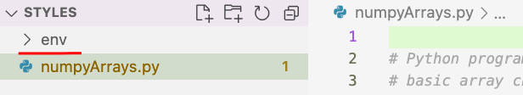
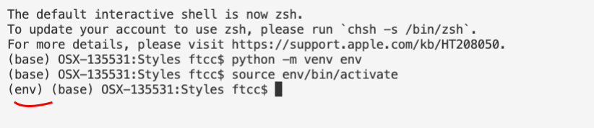
creating Virtual Environment in VS Code
Open the folder that contains program
Create Virtual Environment (below creates a folder named env) python -m venv env
Or
py –m venv env
Or
python3 –m venv env
3. Activate Environment
Mac : source env/bin/activate Windows: .\env\Scripts\activate
If needed, Refer to ppt and video on creating virtual environments for more detail

Slide 5

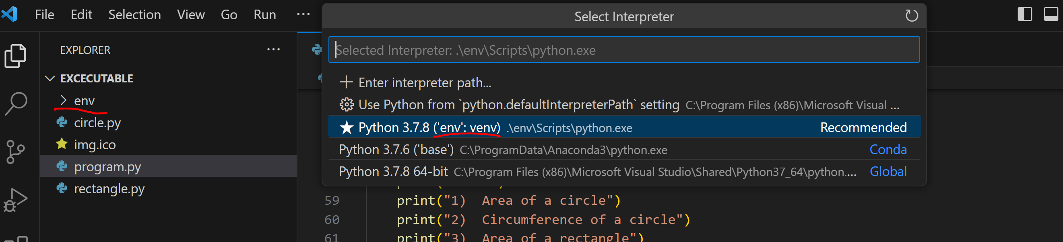
Make sure the virtual environment is selected

Slide 6
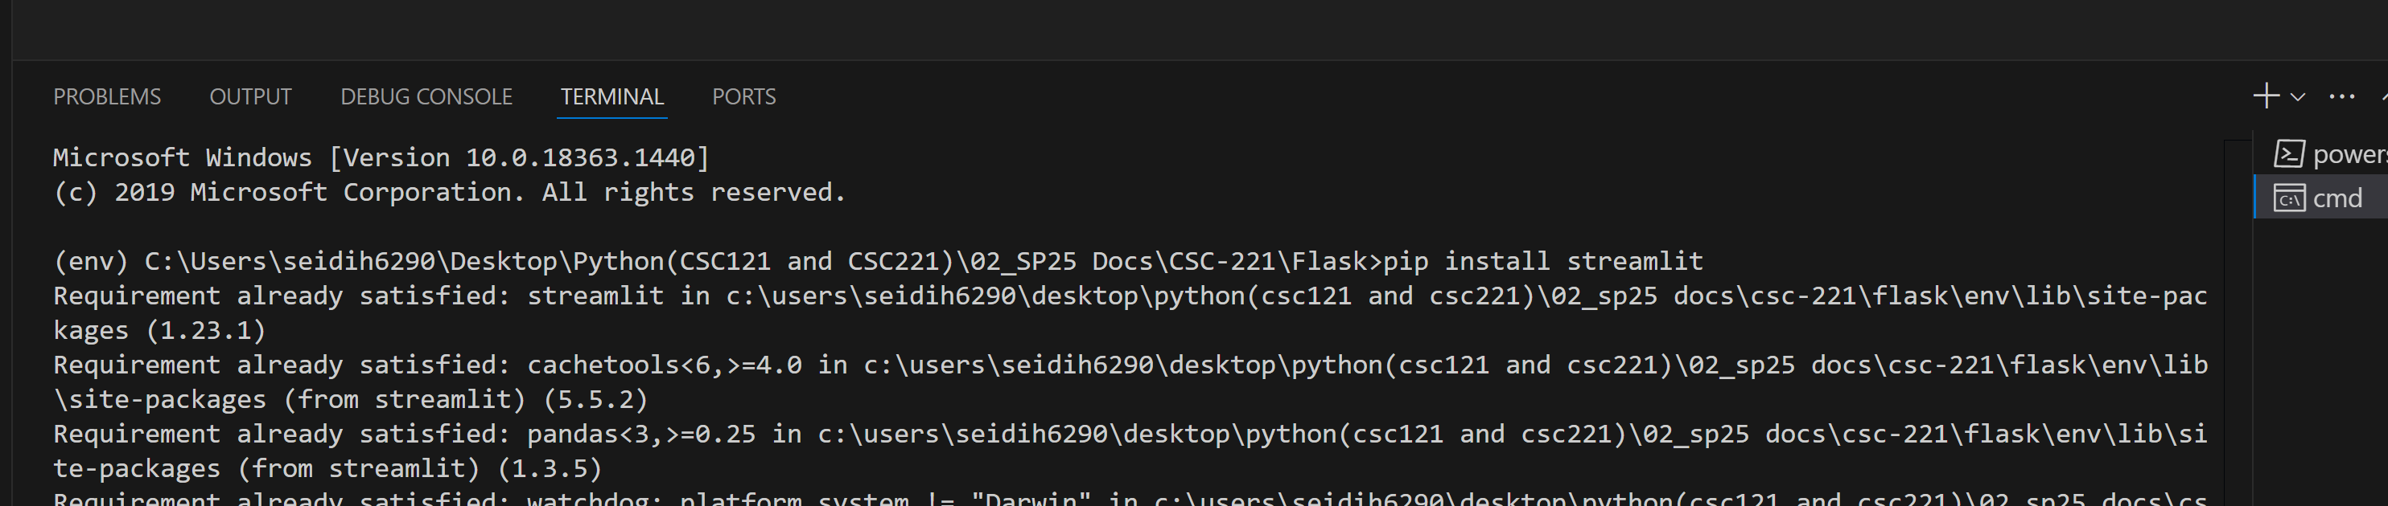
Installing streamlit
streamlit:
python -m pip install streamlit or pip install streamlit
or
Py –m pip install streamlit

Slide 7
Creating an app using streamlit
How to add Text to a streamlit app:
Assuming streamlit was imported as st
import streamlit as st
st.write() : used to handle text, Markdown, and even complex objects like data frames.
St.title() : used to add a title (will appear bigger than remaining content on page)
St.header() : used to set header of a section
St.subheader() : used for subheader sections
St.caption() : used to write a caption
See how to use the above in next page

Slide 8
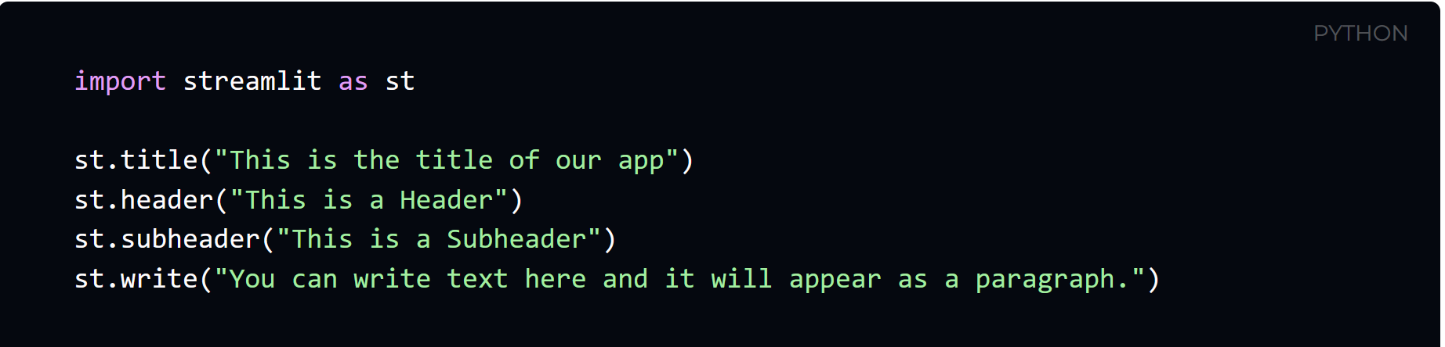
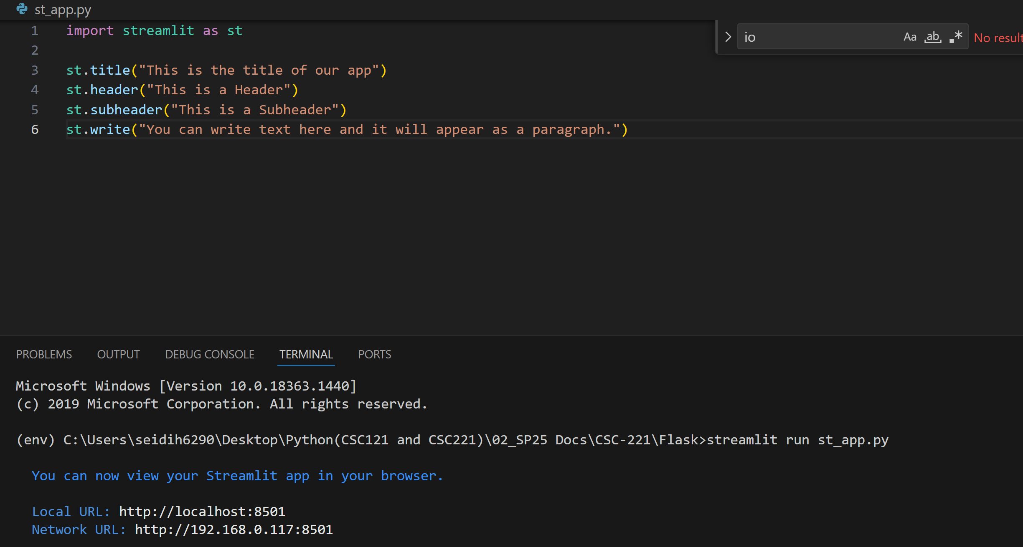
Creating an app using streamlit continued…
1. After pip installing streamlit, create python file. Add code shown in image
2. In terminal , run file using streamlit.
Command “streamlit run filename.py”
In example here the file name is st_app.py
Go to next slide
Notice a url is created after running the application

Slide 9
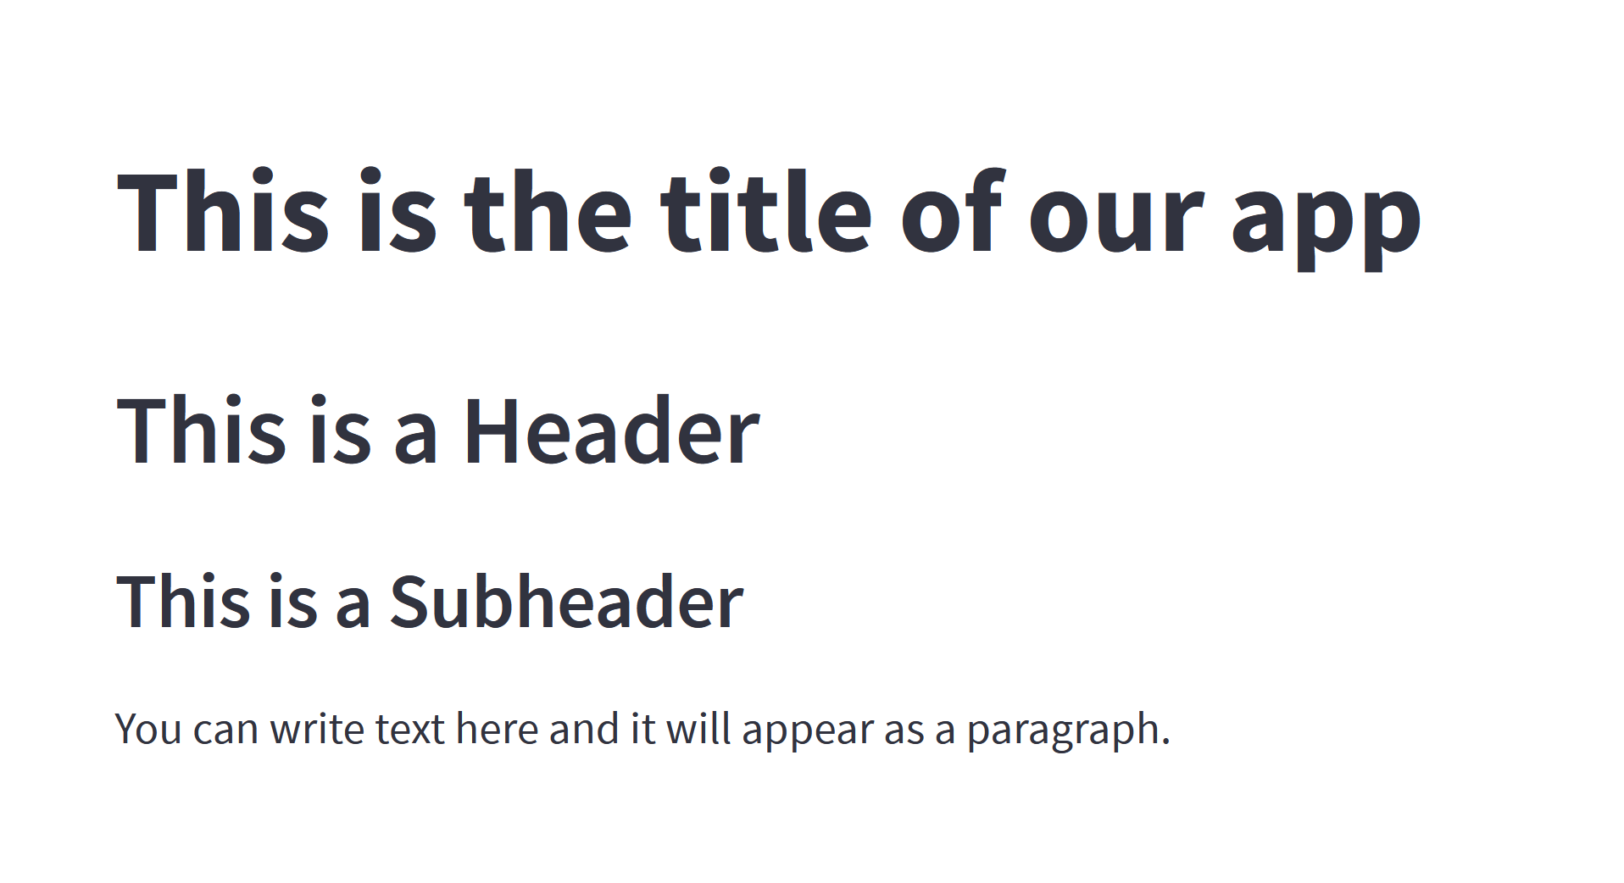
Creating an app using streamlit continued…
1. After pip installing streamlit, create python file. Add code shown in image
The default browser should automatically open after running the app showing results of code added.
If not, ctrl+click the given url and open in browswer
Go to next slide

Slide 10
Creating an app using streamlit continued…
Displaying images or audio
st.image()
st.audio()
st.video()
To add widgets
st.checkbox(): Creates a checkbox that returns a Boolean value.
st.button() : used to display a button
st.radio(): used to add radio buttons.
st.seelctbox(): used to allow user to choose from a series of items, allows selecting from list or a column from a DataFrame.
st.multiselect(): used to allow users to choose from a series of multiple selections, used to filter a DataFrame based on one or more values of a column.
st.slider(): displays a slide bar allowing a user to choose a number that is within a certain range.

Slide 11
Creating an app using streamlit continued…
For direct user input
st.number_input(): used to allow user to enter numbers.
st.text_input() : used to allow text input
st.date_input(): displays a date widget that a user can select from.
st.time_input(): displays a time input widget allowing user to select time.
st.file_uploader(): used to display the file uploader widget which allows a user to select a file from folder.
Other useful widgets
st.progress(): used to display a progress bar.
st.error(): used to display an error message
st.warning(): to display a warning message
st.success() : used to display a success message
For more widgets, check the resources slide

Slide 12
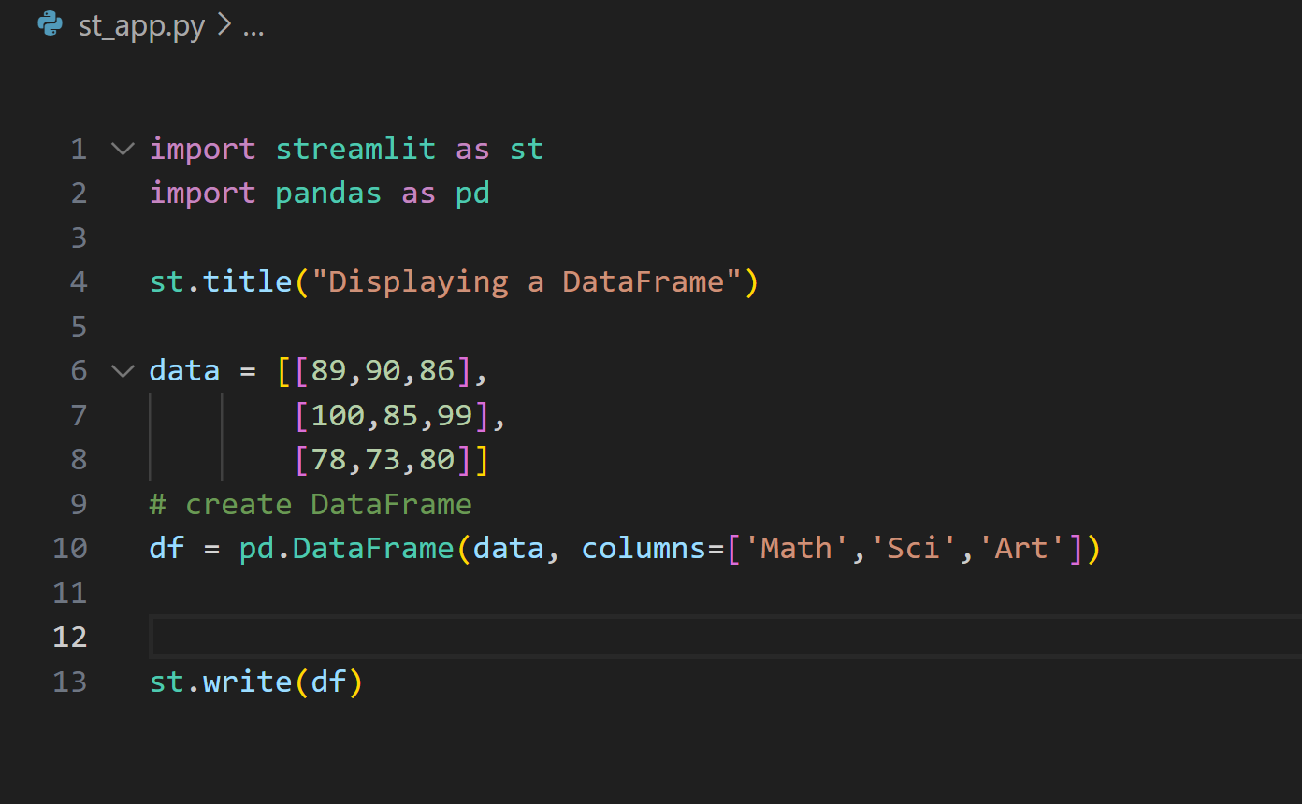
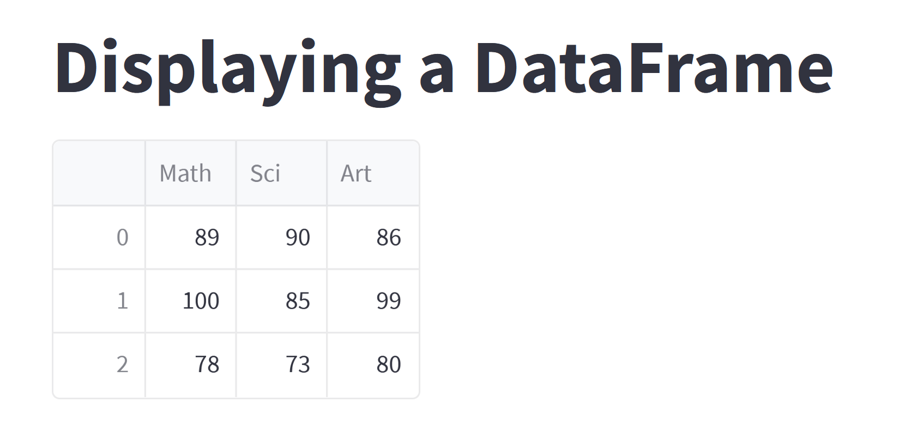
2 Creating static dashboards
Read content into a DataFrame
Use st.write() method to display a DataFrame in a dashboard
streamlit run st_app.py

Slide 13
2 Creating static dashboards continued…..
Adding Charts to Dashboards
Can be done using the following:
streamlit built-in methods : Such as examples shown below . st.line_chart() . st.bar_chart()
Using Matplotlib pyplot library

Slide 14
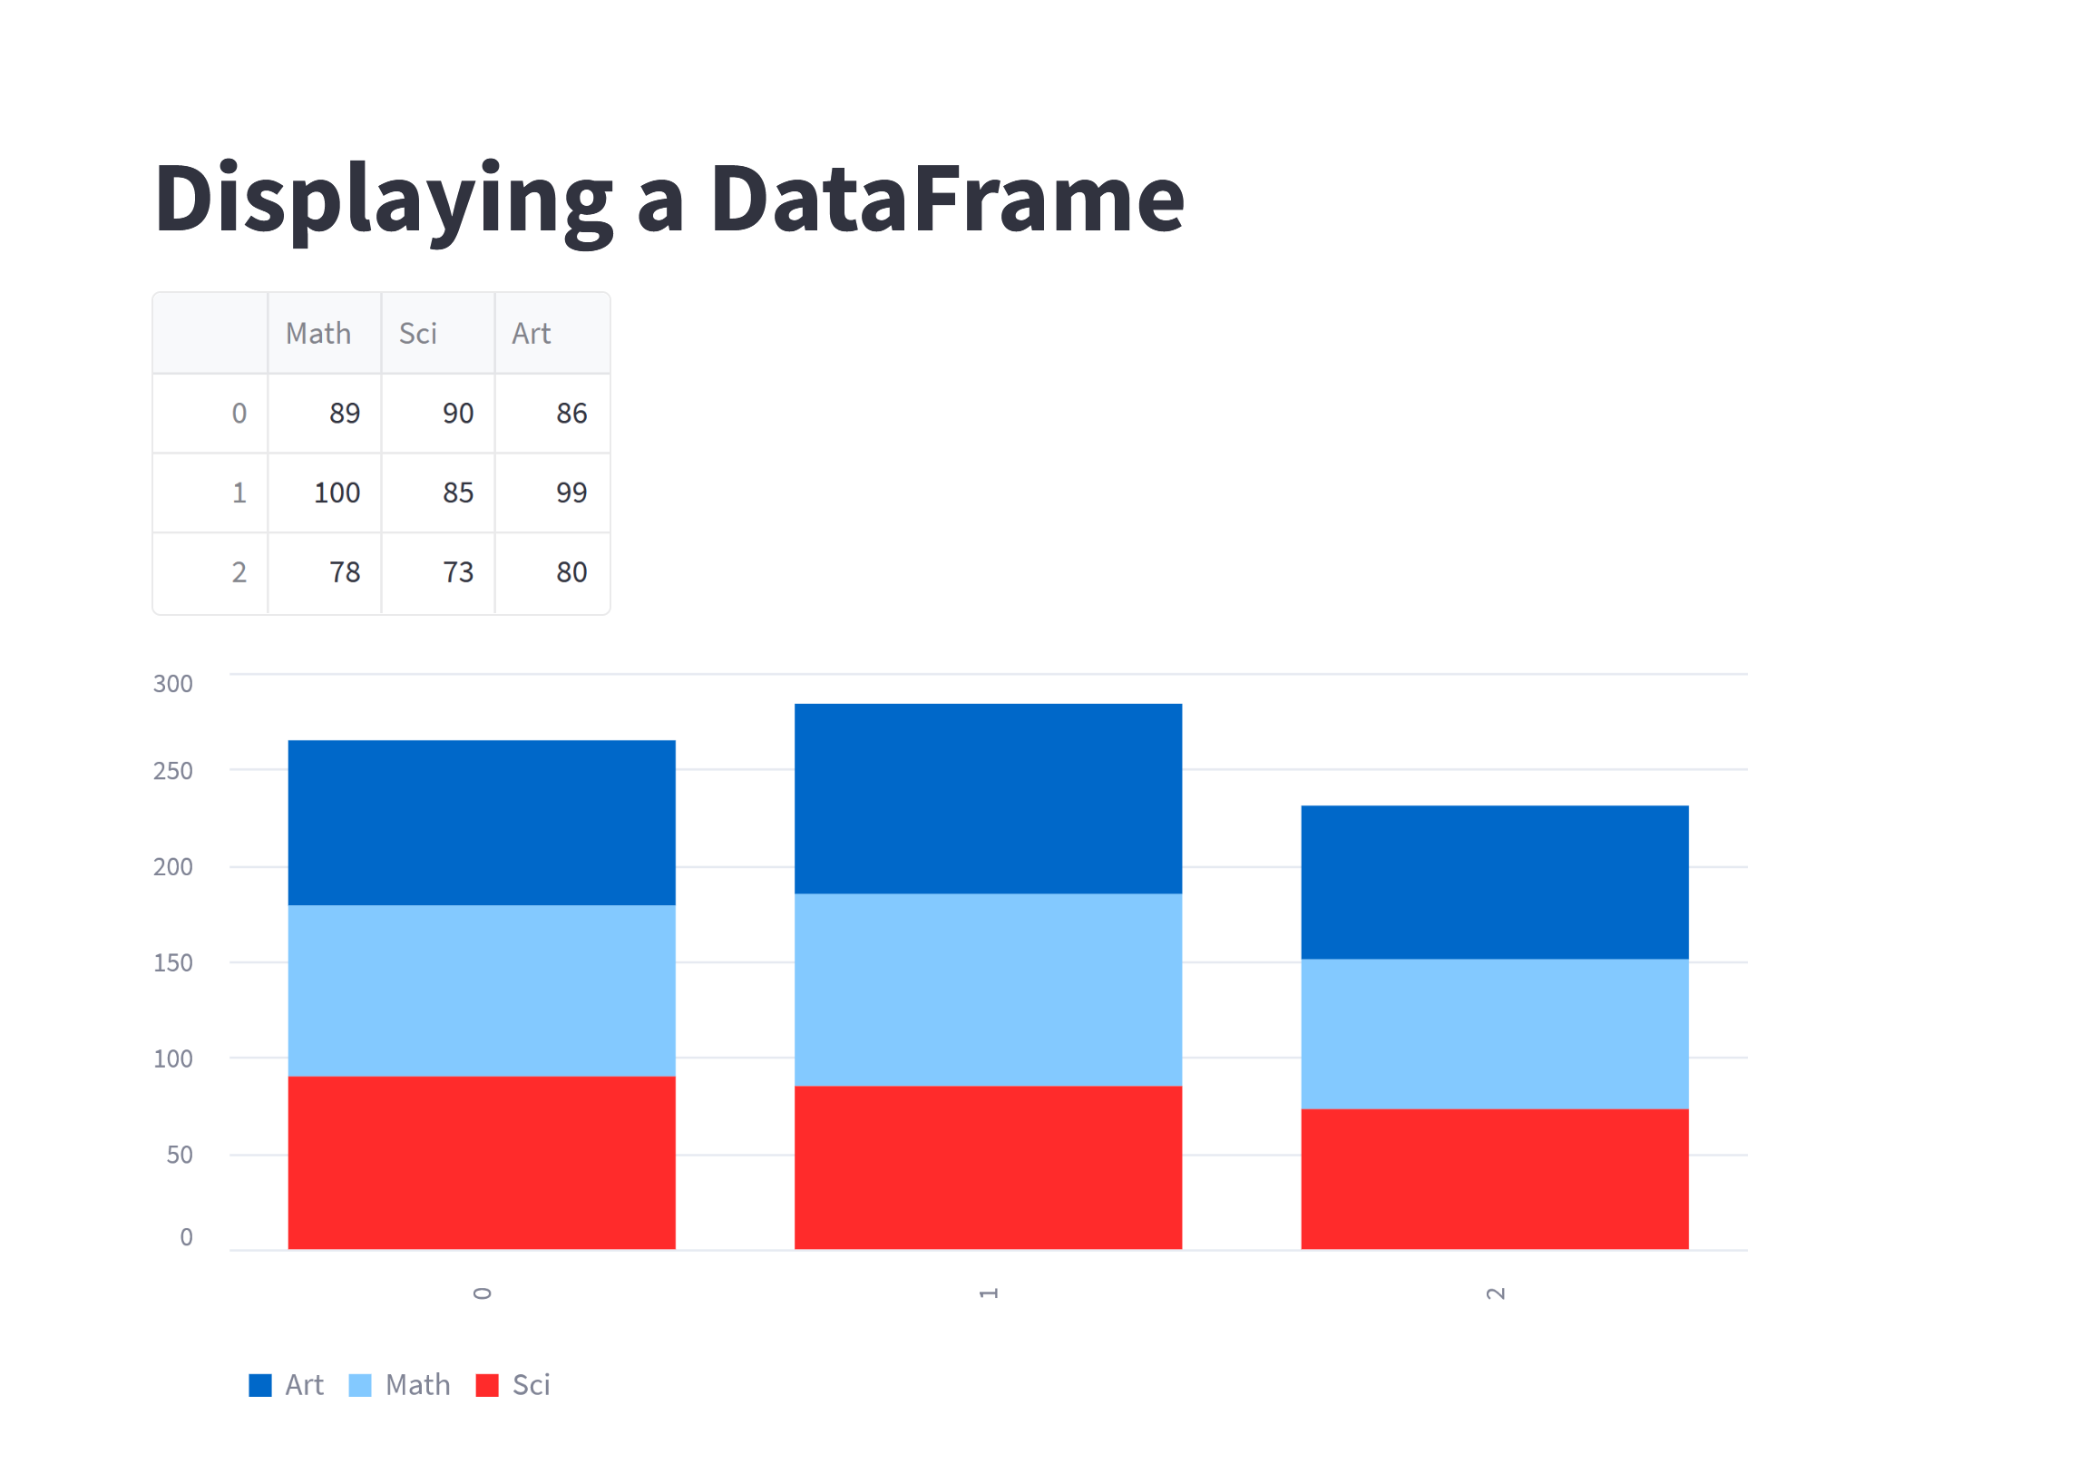
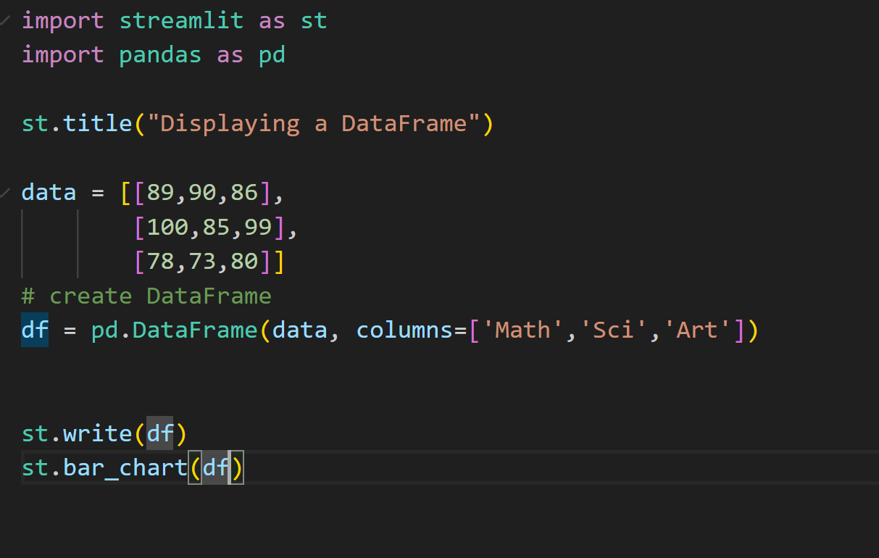
2 Creating static dashboards continued…..
Example Using streamlit built-in methods

Slide 15
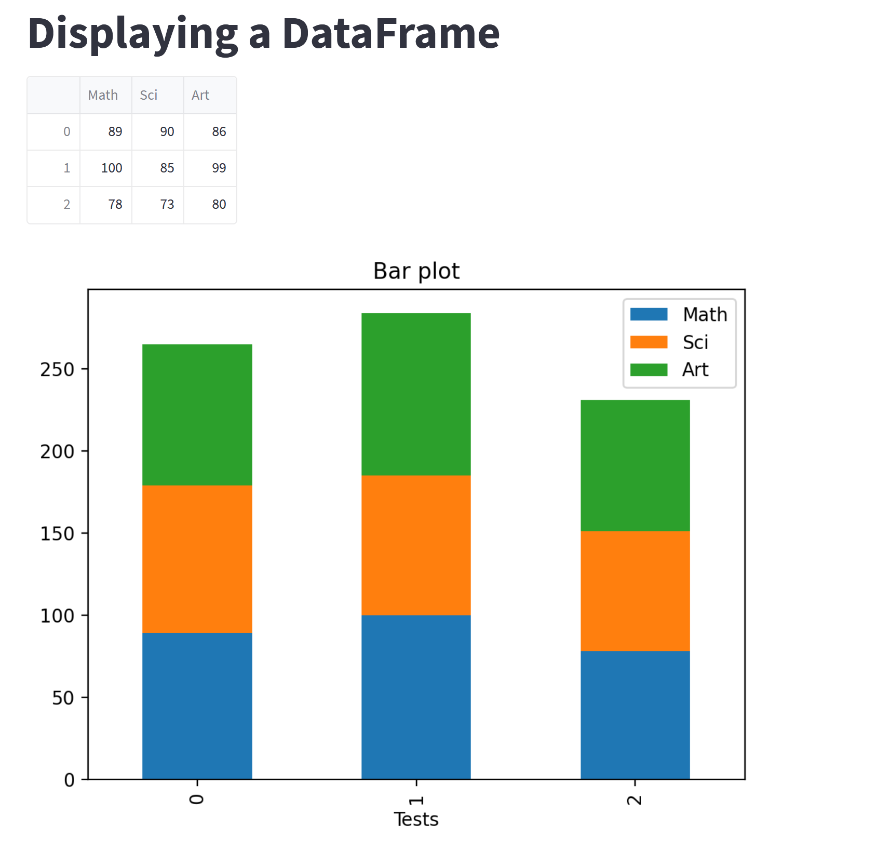
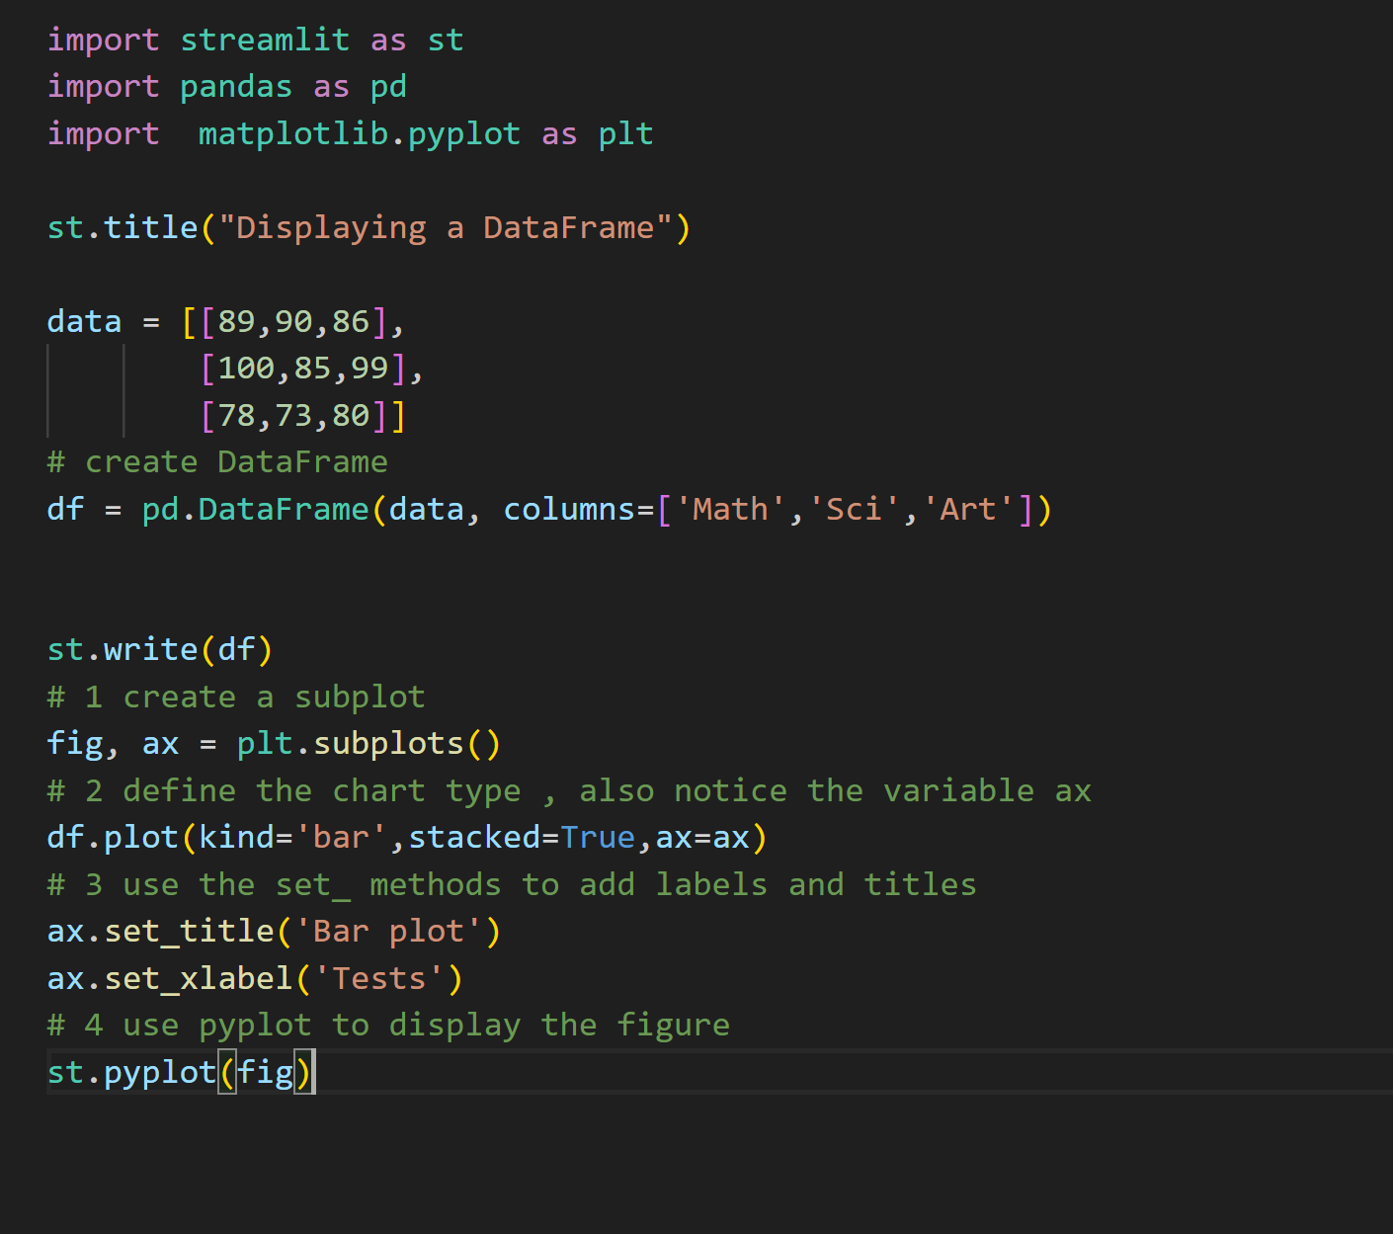
2 Creating static dashboards continued…..
Example Using Matplotlib pyplot library

Slide 16
3 Adding Sidebars and filters
Sidebars and commonly used to add dashboard filters.
Streamlit allows adding a sidebar using the st.sidebar attribute.
Process
Add a sidebar using st.sidebar followed by the widget you want to add.
Add filter(s). For example , these could be based columns , rows , both columns and rows
Apply filters on DataFrame and plot
Example in following slide

Slide 17
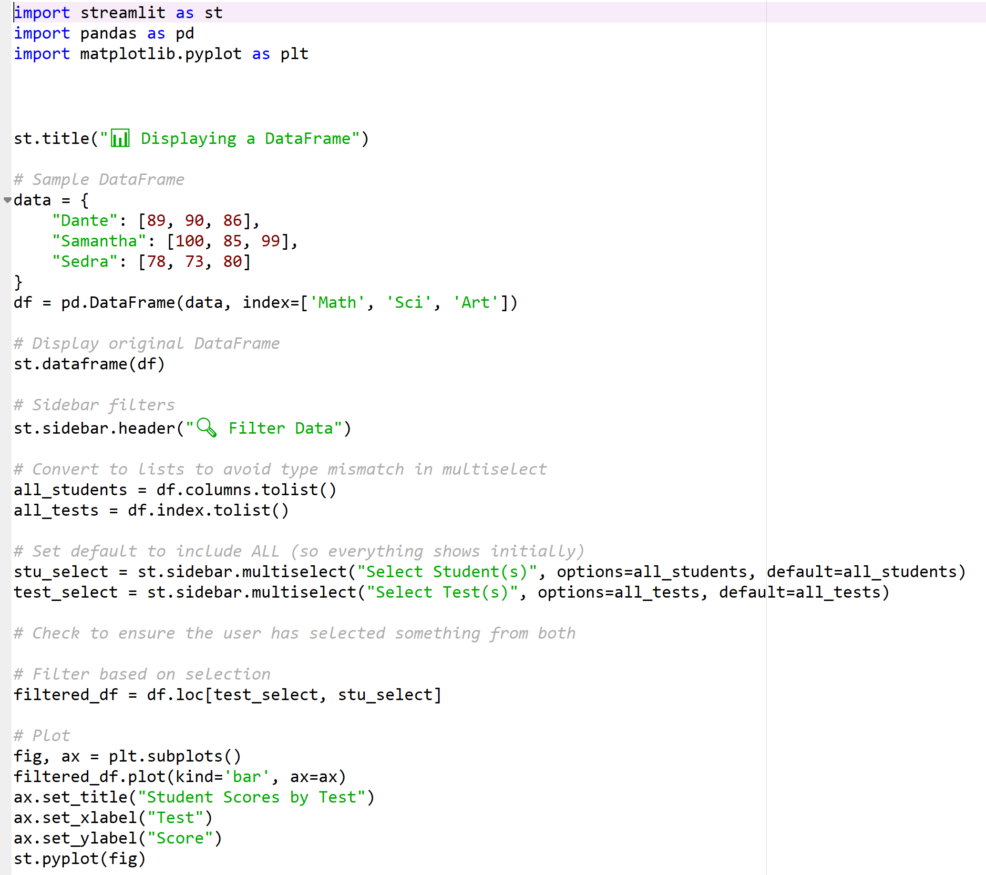
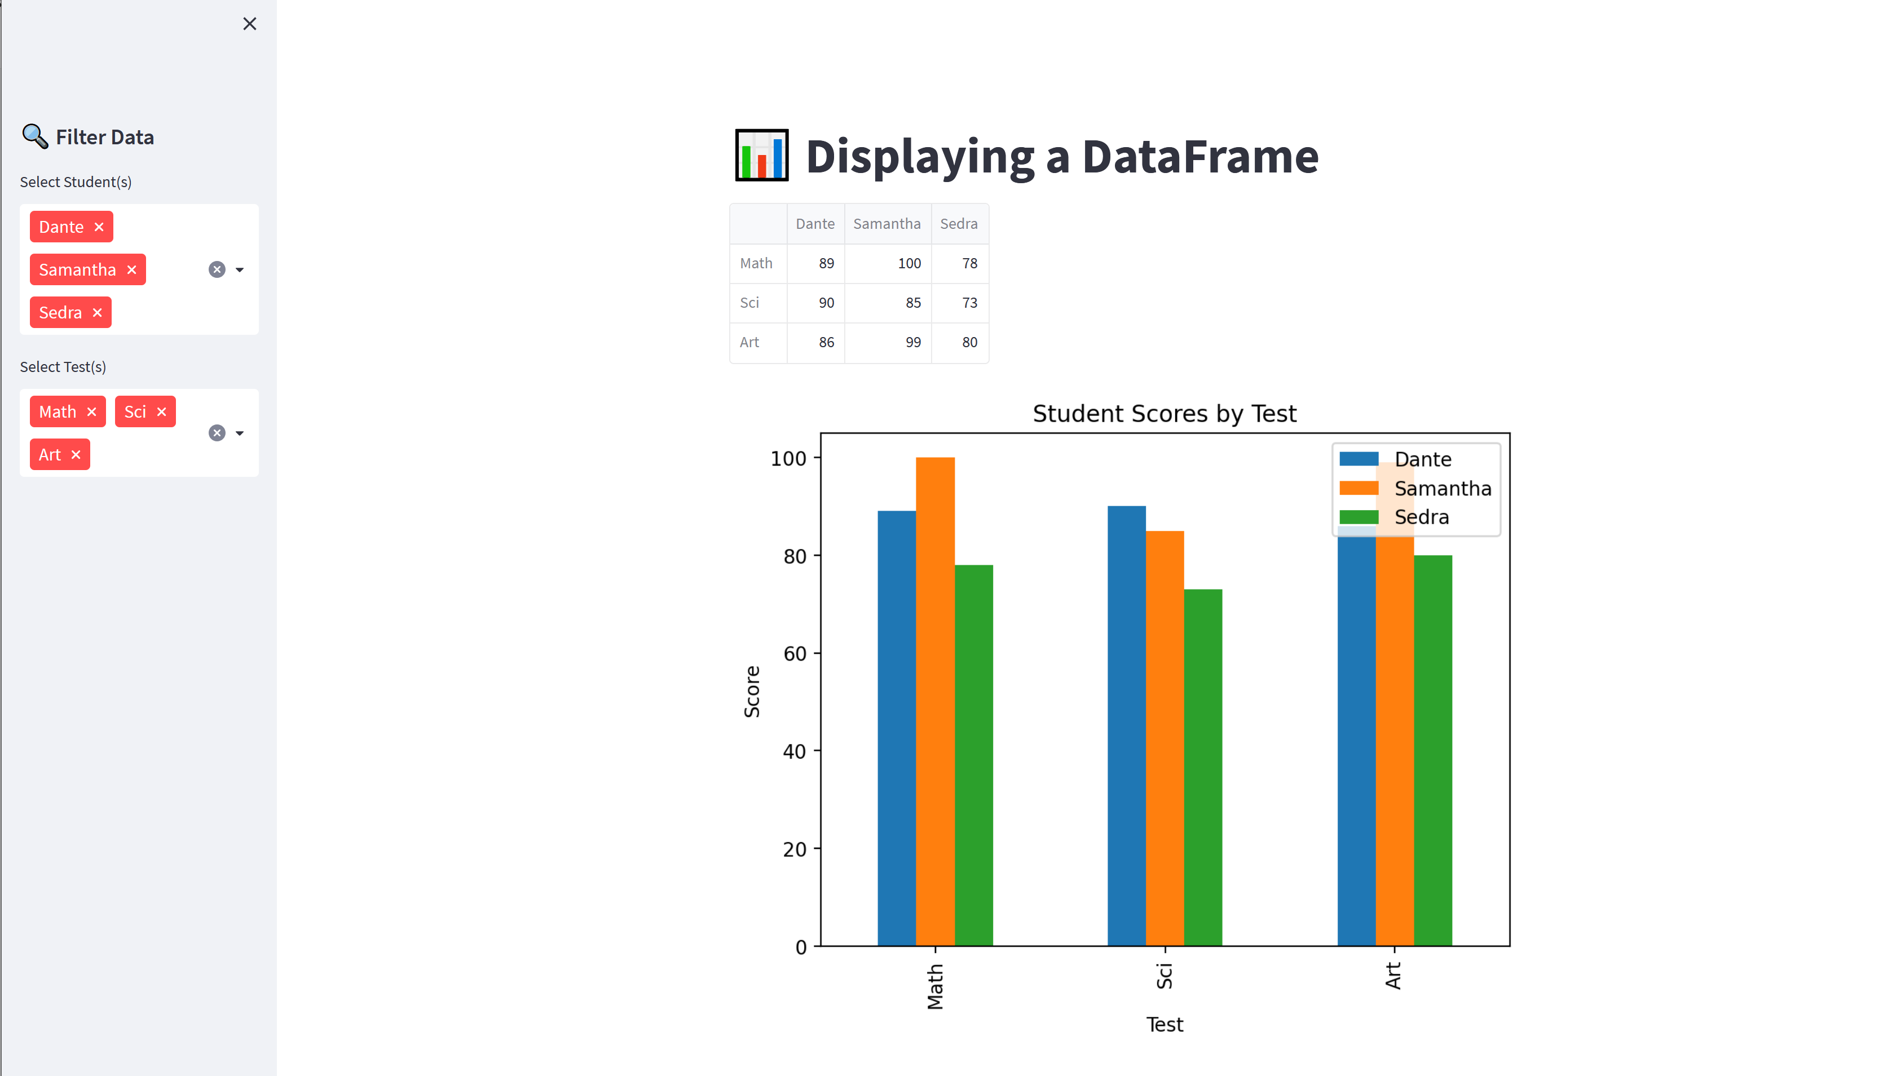
3 Adding Sidebars and filters continued…
1. st.sidebar.header() used to add sidebar
2. Filters added
3. Filters applied on plot

Slide 18


4 displaying content in different page
Opening a new page using streamlit
project folder
Have the right folder breakdown, see example
Content in the homepage will appear in the first page of app
List of files under the “pages” folder will appear in the sidebar on the homepage.
main python file(home page)
pages
Other python files in subfolder(pages)
Example in following slide

Slide 19
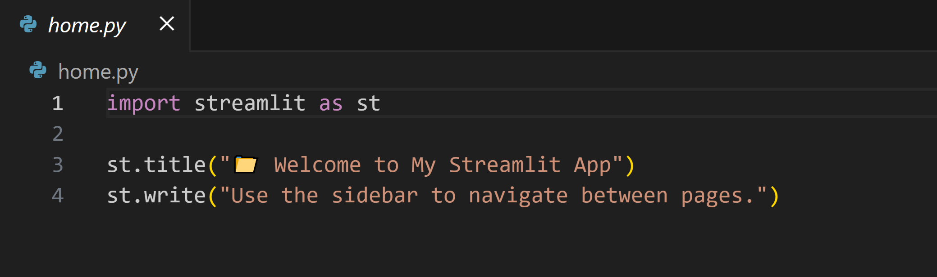
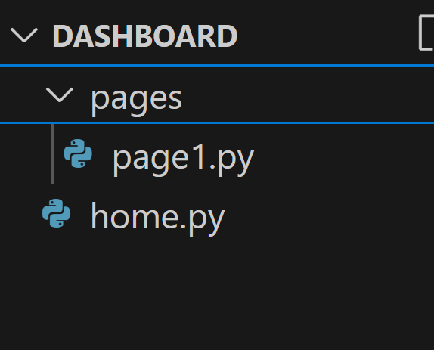
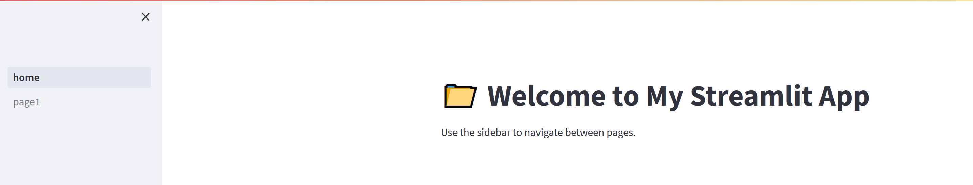
4 displaying content in different page
When running “streamlit run home.py” sidebar displays names of file(s) in the “pages” folder
Notice “home.py” is in the root folder.
Example in following slide

Slide 20
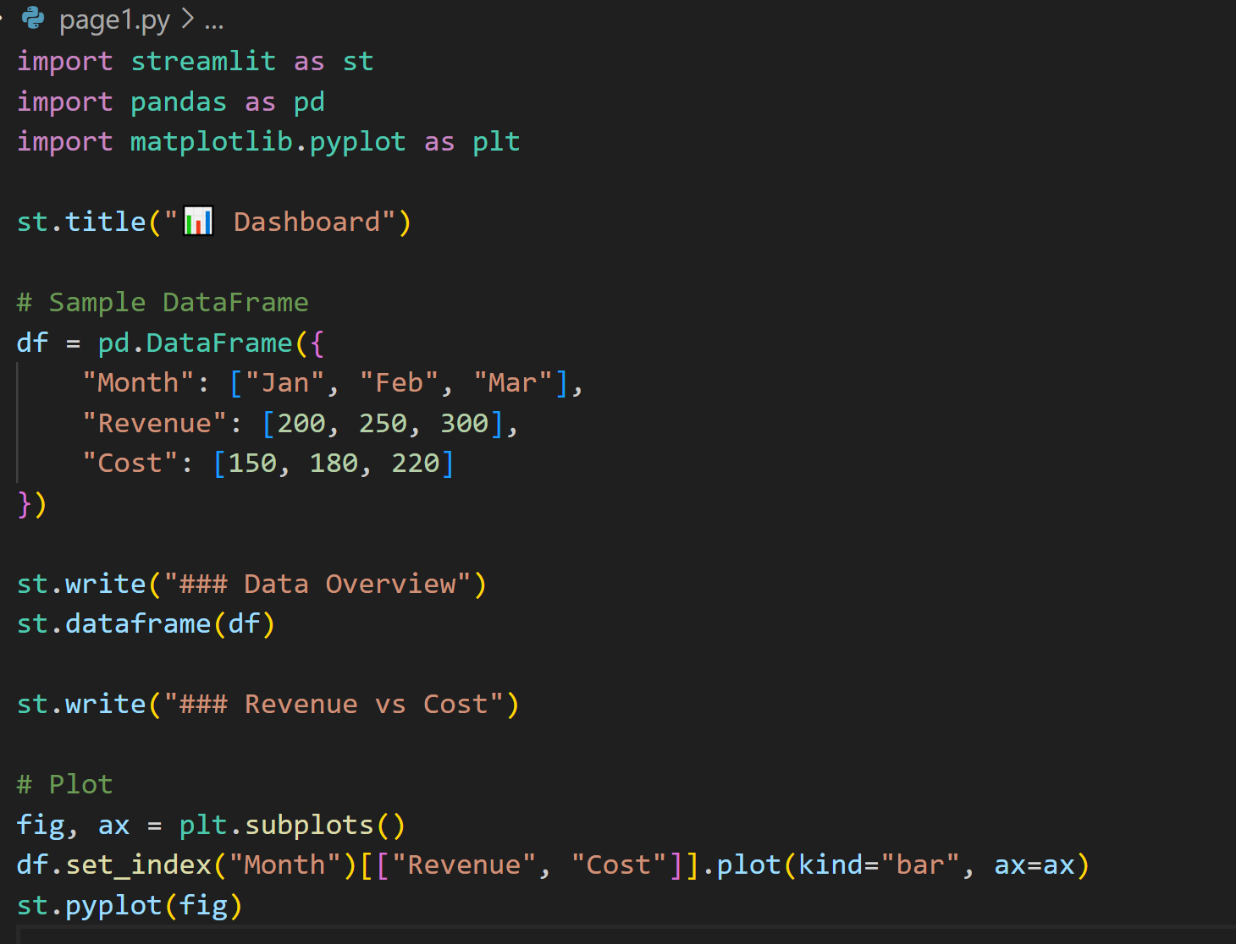
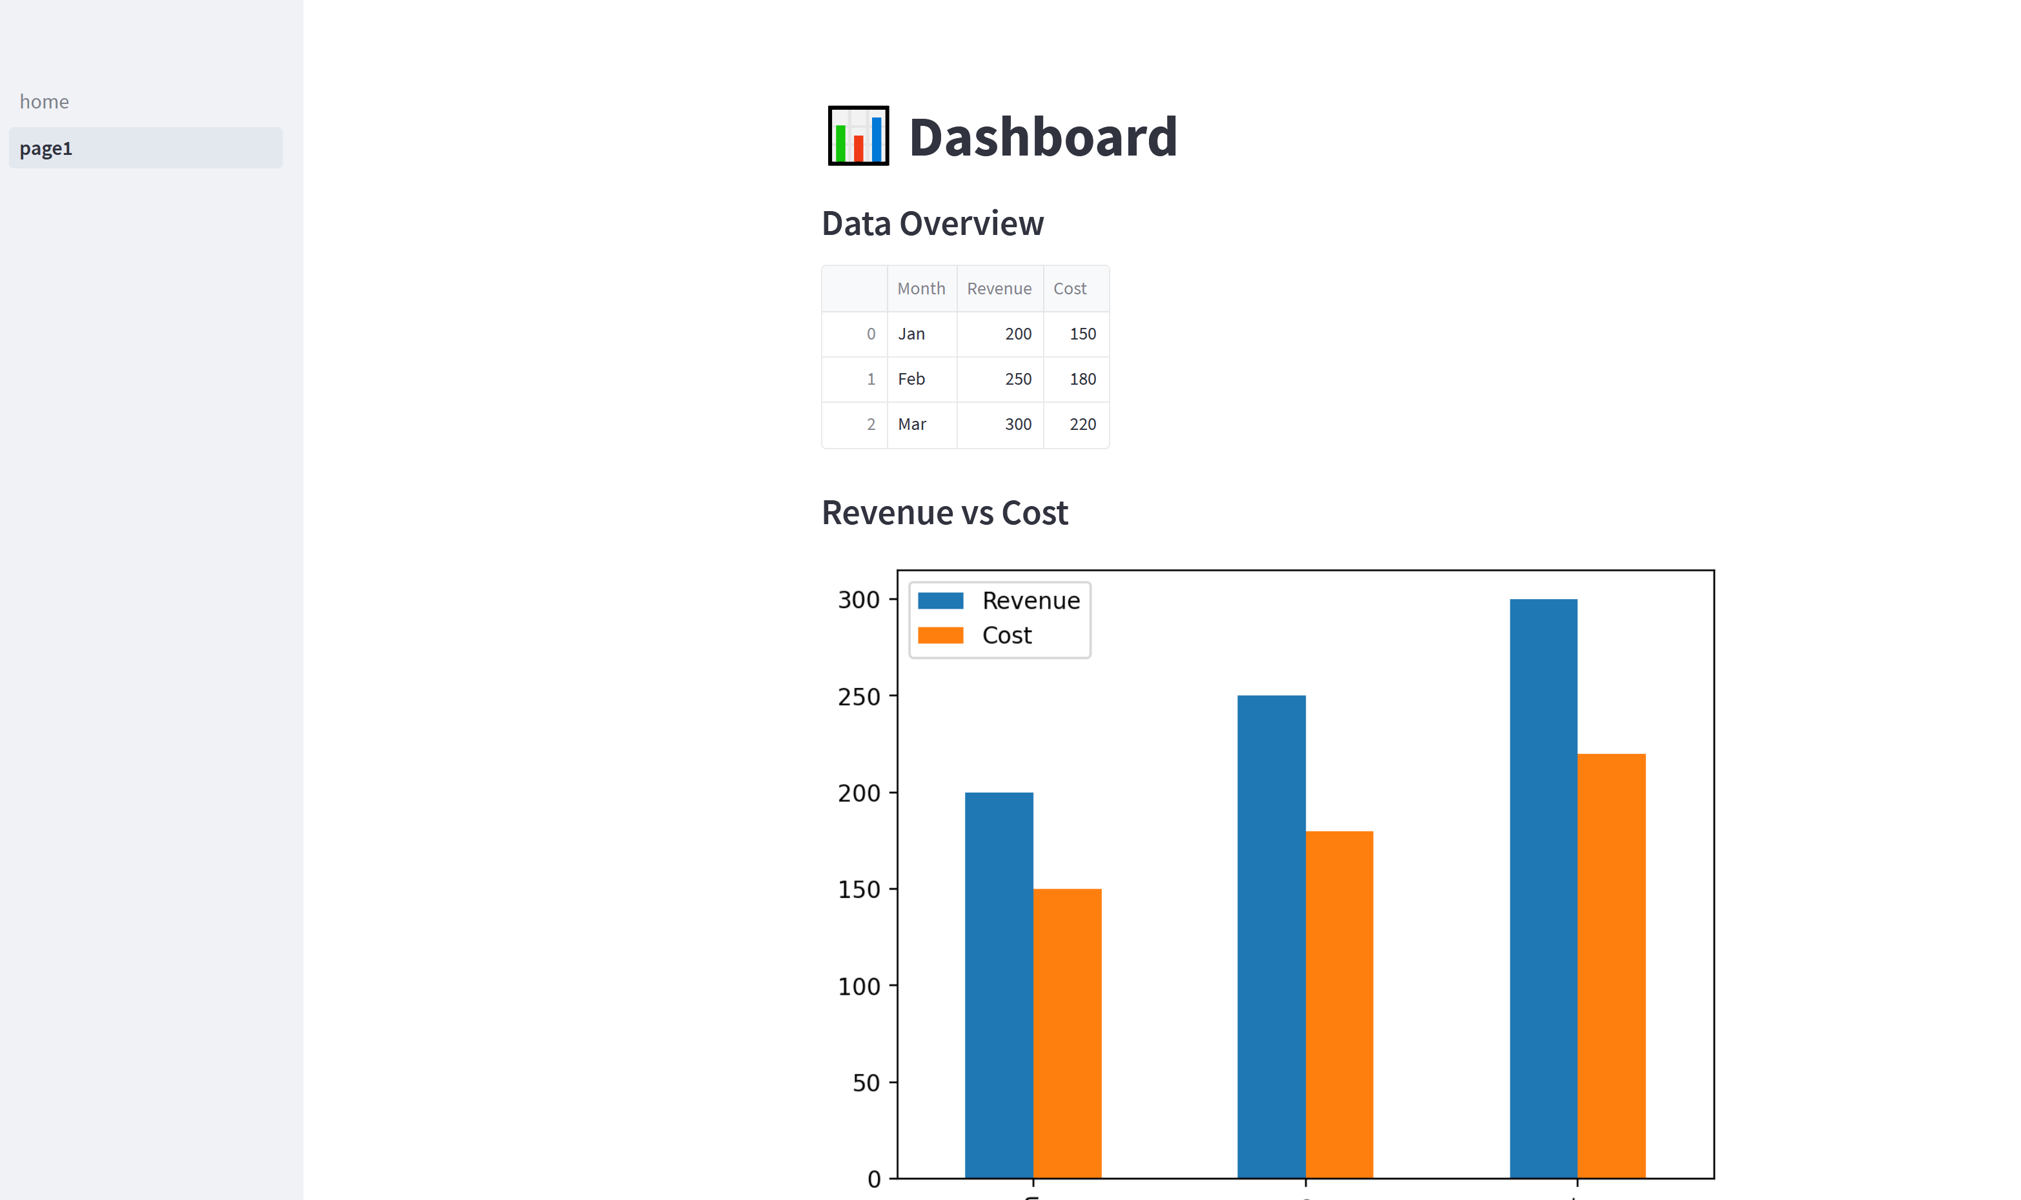
4 displaying content in different page continued…
When clicking a file name that appears in the sidebar, the content is displayed
If the subpages have a sidebar, see next slide

Slide 21
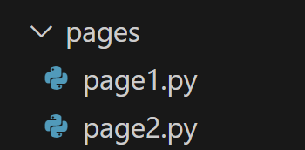
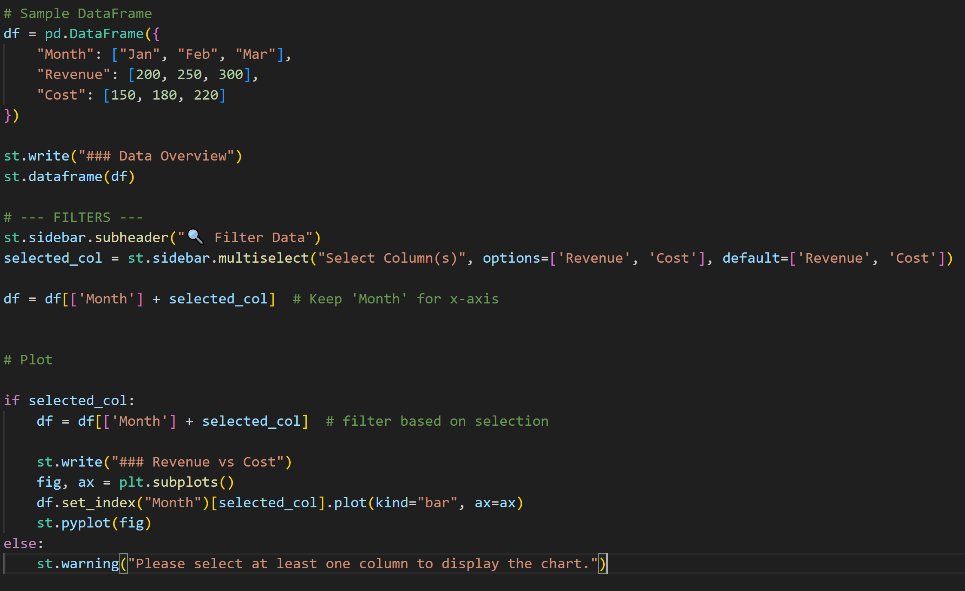
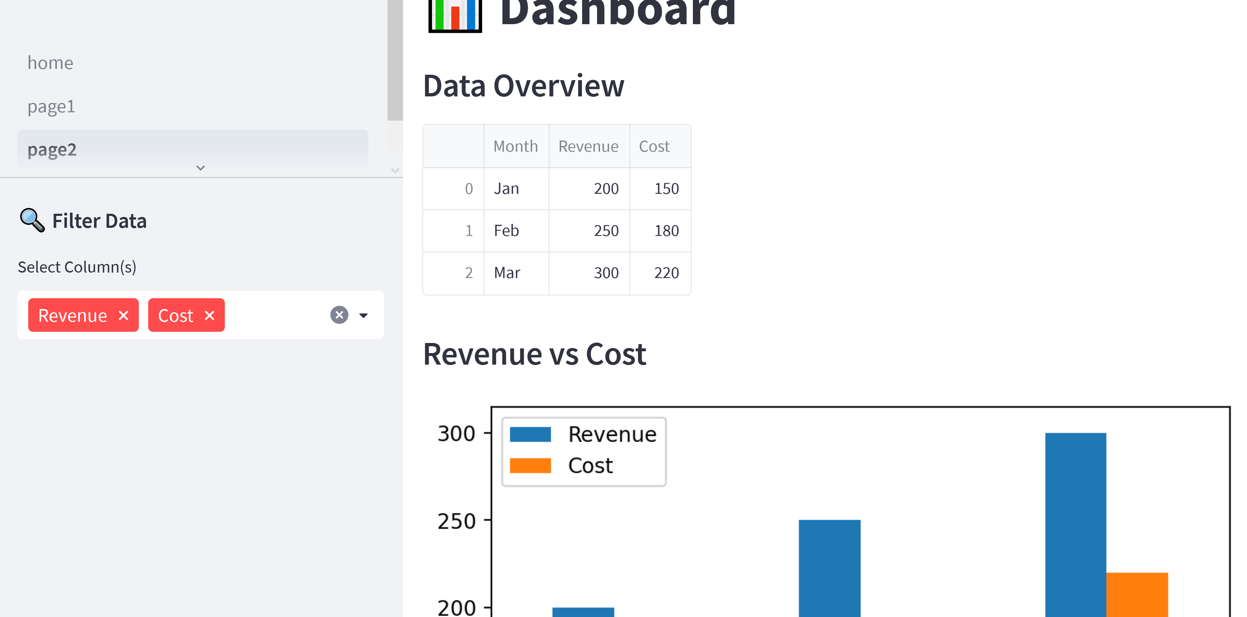
4 displaying content in different page continued…
If wanting to add sidebar to page2.py , use st.sidebar.subheader()

Slide 22
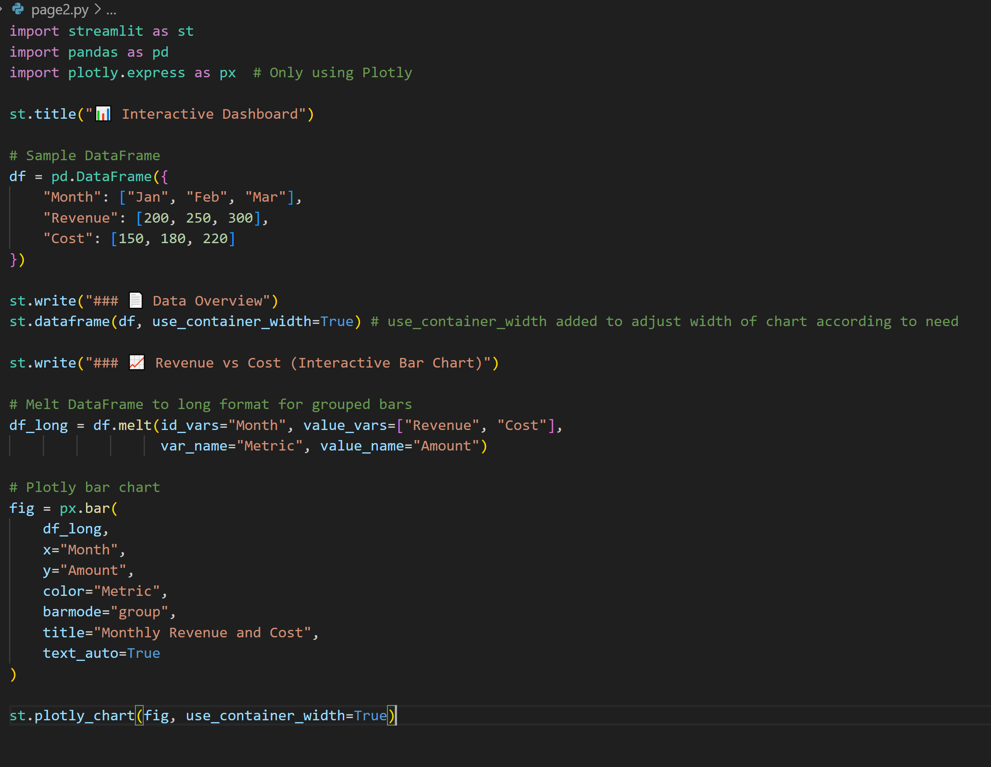
5 Interactive dashboards
Must import “plotly.express” for interactive plotting
Assign st.dataframe() “use_container_width” attribute a value of “True” added to adjust width of chart according to need
Use df.melt() to adjust chart width
Use plotly.express to plot adjust chart

Slide 23
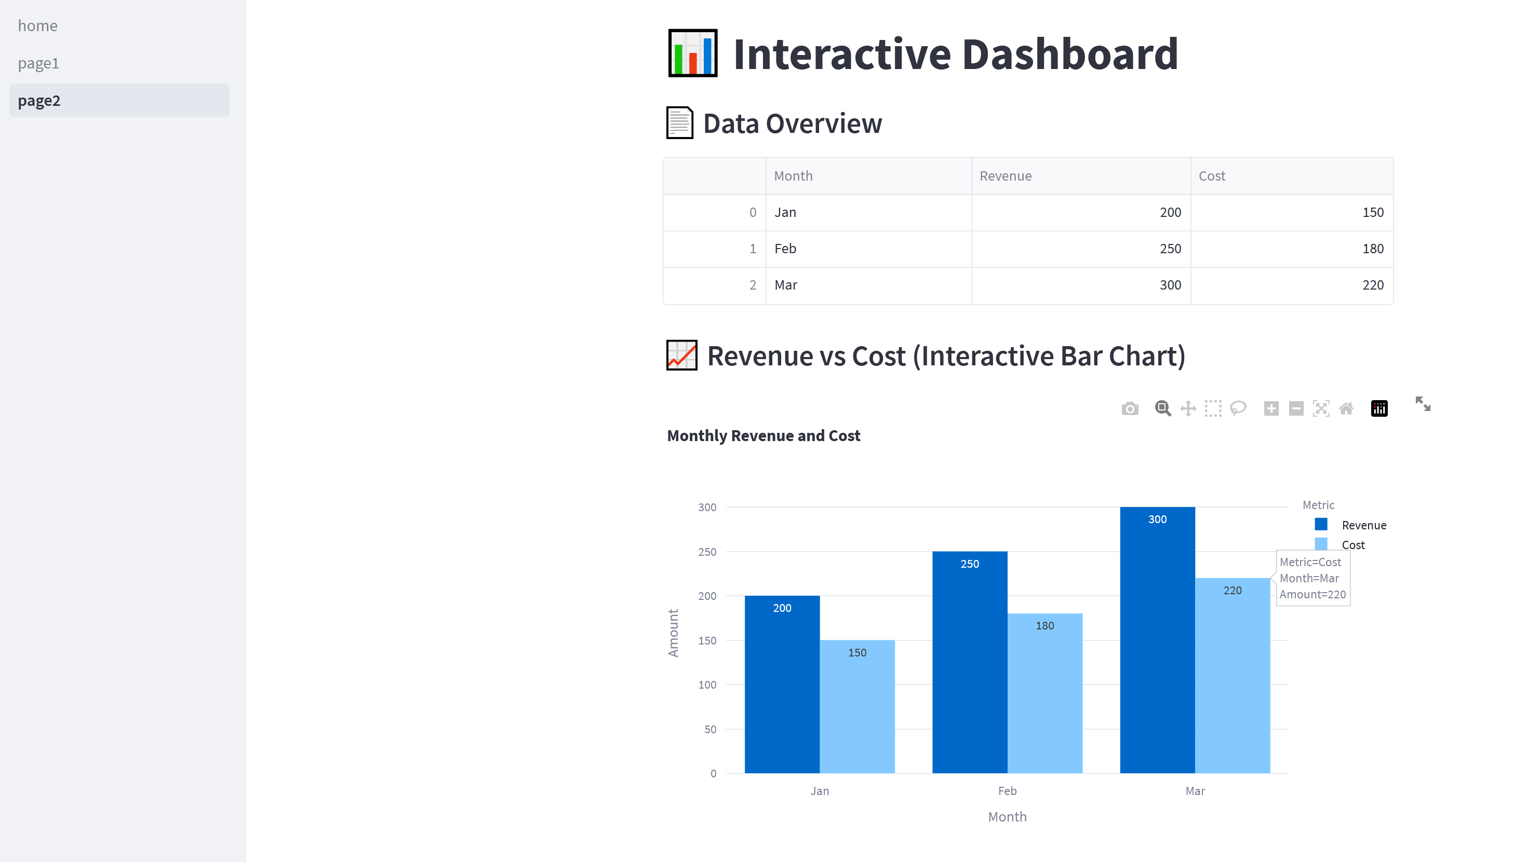
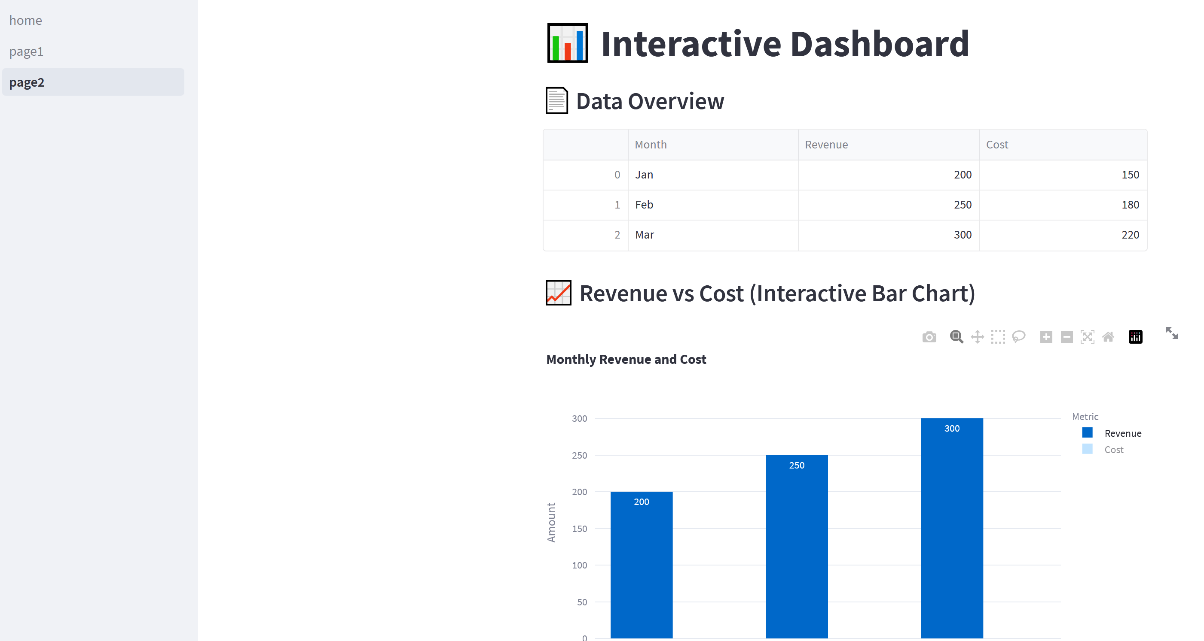
5 Interactive dashboards continued…
Click to hide/show category in chart (notice the difference between this chart and the one on the left)
Tips appear when hovering over chart content

Slide 24
resources
https://www.pythonguis.com/tutorials/getting-started-with-streamlit/
https://blog.streamlit.io/crafting-a-dashboard-app-in-python-using-streamlit/#3-build-your-dashboard-with-streamlit
https://kawarithm.com/interactive-dashboards-with-plotly-and-streamlit/

